Slide 1
INTERNSHIP DEMO - 1
Done By :-
R Krishn Vaibhav
6BCA
21215059

Slide 2
About the company
MariApps is a company that provides digital solutions for the maritime industry
MariApps is a global company headquartered in Singapore, with development centers in India and sales and support offices in Germany, Singapore, India, Japan, Cyprus, UAE, France, USA, Saudi Arabia
MariApps develops and implements software solutions for ship owners, ship managers, and charterers. Their flagship product is smartPAL, a comprehensive maritime digital software suite that provides end-to-end solutions for efficient maritime operations. They also offer customized applications and software solutions.

Slide 3
My role
In my role as a mobile developer intern, I primarily use Flutter for coding.
As of now my work is divided into two parts – 50% is dedicated to research and development , and the other 50% involves hands-on coding.
This balanced approach not only allows me to strengthen my coding skills but also provides an opportunity to explore and contribute to innovative solutions in mobile development.
Engaging in research activities enables me to stay updated with the latest trends in the field and enhances my understanding of the broader aspects of mobile technology.
It's a well-rounded experience that combines practical coding with the excitement of exploring new ideas and approaches in the dynamic field of mobile development.

Slide 4
Tasks done
During the first 20 days of my internship, I focused on learning how to use the Flutter framework, which is a crucial tool for mobile programming.
This required me to take an organized approach to studying through an Udemy course, where I methodically studied every aspect of Flutter.
In order to strengthen my academic understanding, I worked on practical projects at the same time, making MP3 players and chat apps.
These projects gave me invaluable expertise in creating useful mobile applications in addition to providing platforms for putting what I learnt into practice.

Slide 5
TASKS DONE
I completed a variety of tasks as part of the research and development (RnD) component of my internship to deepen my awareness of the larger field of mobile application development.
I started with market research, looking into solutions that could improve code coverage and help with productive code reviews. This investigation revealed methods and resources used by the industry that are essential to guaranteeing reliable software development.
After that, I turned my research and development attention to using Artificial Intelligence (AI) tools to make coding tasks in the Android Studio environment simpler. By exploring how AI may be used in practice to enhance the productivity of mobile development workflows, this research aims to broaden my skill set.

Slide 6
TASKS DONE
Researching technologies intended to simplify app flavoring—a confusing component of mobile application development—was a significant new feature of my research and development experience. The research resulted in a thorough demonstration of the flutter_flavorizr tool, which I presented to my colleagues to show them its usefulness. In addition to confirming my comprehension, this interactive presentation gave me the chance to impart insightful knowledge to my colleagues.
As I entered a critical stage of my internship, I started working on Eyesea, a project that was still going on inside the company. The non-profit Eyesea is dedicated to monitoring marine risks and global pollution using crowdsourcing data gathered through their mobile application. The program is available to the general public via the Play Store, but it also has issues with unresolved change requests (CRs) that need to be addressed.

Slide 7
TASKs done
During the final week of this immersion, I assumed responsibility for two particular Change Requests (CRs). The leaderboard module was the first module we focused on, and the map module from the Eyesea project was the second. Considering the complexities of the map module, the given work comprised dynamically displaying the weather conditions on the map whenever the user scrolled to a new point and updating them as needed. By effectively resolving these particular CRs, I was able to significantly improve the functionality of the leaderboard and map.

Slide 8

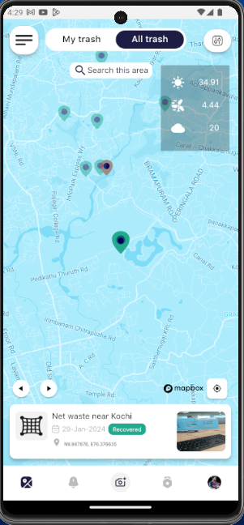
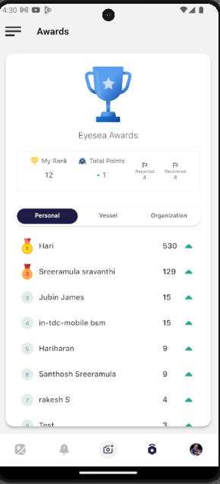
UI

Slide 9
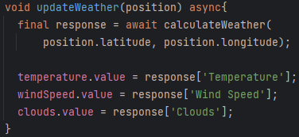
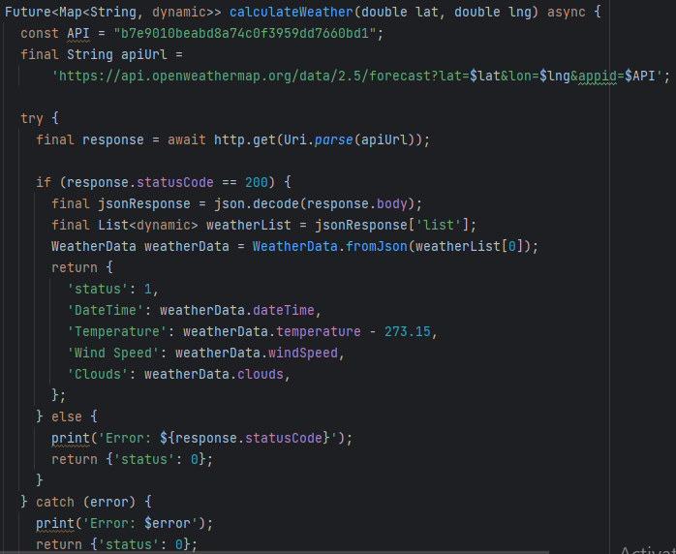
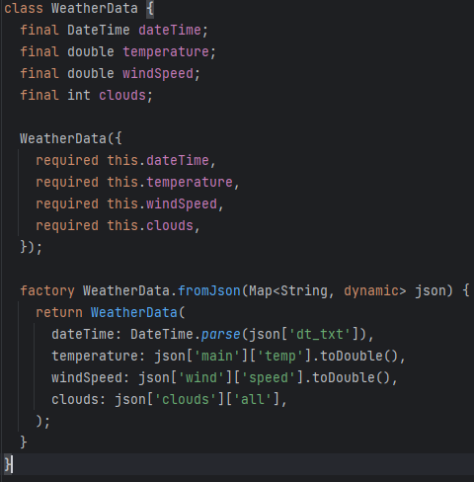
CODe snippets

Slide 10
THANK YOU

